Slide 1

BASIC OF ROCKETRY AND PARACHUTE DEPLOYMENT

Slide 2
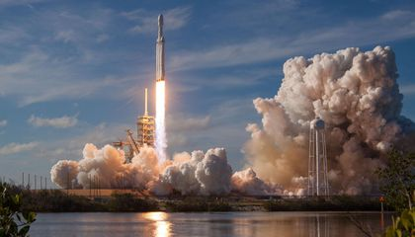
“When you fly to the moon you don't need a rocket. You just need the imagination!”

Slide 3
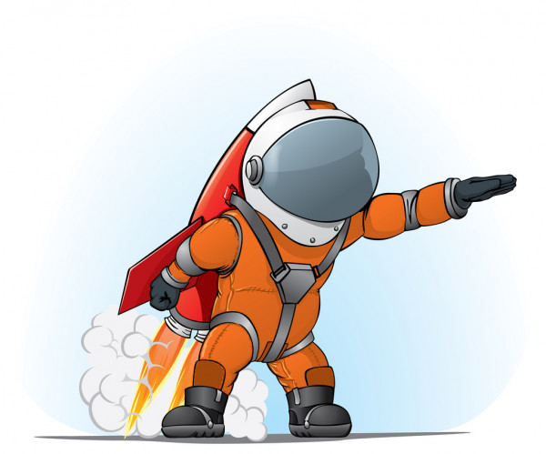
Introduction
The branch of science that deals with Rocket and Rocket propulsion is called “Rocketry”.
Rocket is a long cylindrical device that can be launched in to air. Rocket means a type of engine also. The word Rocket can also be used for a device that uses the engine also.
A guided missile is Rocket and the firecracker we burn is also a rocket and the spacecrafts that goes to the outer space is also rocket.
The first rockets were used by china in the 1200s.

Slide 4
Topics Covered
1
2
Brief History and Modernisation of Rocket.
Important Laws and Equations.
Propellent and it’s type.
Nozzle and Combustion Process.
Model Rocket.
Stability of a Rocket.
Parachute Deployment.
3
4
5
6
7

Slide 5
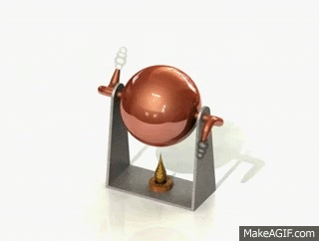
History and Modernisation of Rocket Science
Hero Steam Engine-
It wasn’t a rocket or jet, but gave basic idea about
Propulsion.
It was designed by Hero of Alexandria using the
Concept of a steam engine.
He filled a sphere with water having two L shaped tubes at opposite end with a burner beneath it.
The water converted to steam and came out of the tubes giving thrust and making the cylinder rotate.

Slide 6
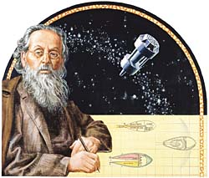
History and Modernisation of Rocket Science
Konstantin E. Tsiolkovsky
He was a Russian school teacher.
Suggested the idea of space exploration using a
Liquid propellant filled rocket.
Renowned as “Father of Modern Astronautics”.

Slide 7
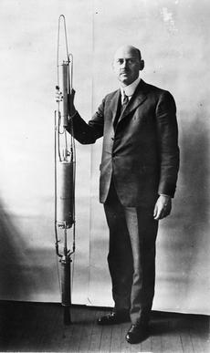
History and Modernisation of Rocket Science
Robert H. Goddard
Referred as “Father of Modern Rocketry” was an American
Professor and scientist.
Built and flew first liquid propellant rocket on
March 16, 1926.
Height reached was 12.5m.

Slide 8
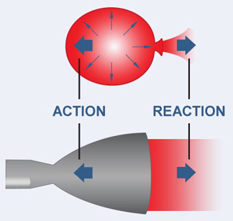
Important Laws and Equations.
Rockets takes off on the principle of “Newton’s Third law of Motion” i.e. “Every action has an equal and opposite reaction”.
Rockets works similarly as a balloon does.
Compressed gases ejects from a hole
giving a thrust in opposite direction.

Slide 9
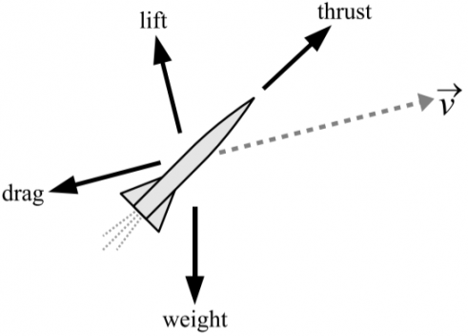
Important Laws and Equations.
Forces acting on a Rocket
Four main forces acts on a rocket-
1.Thrust
2.Weight
3.Lift
4.Drag

Slide 10
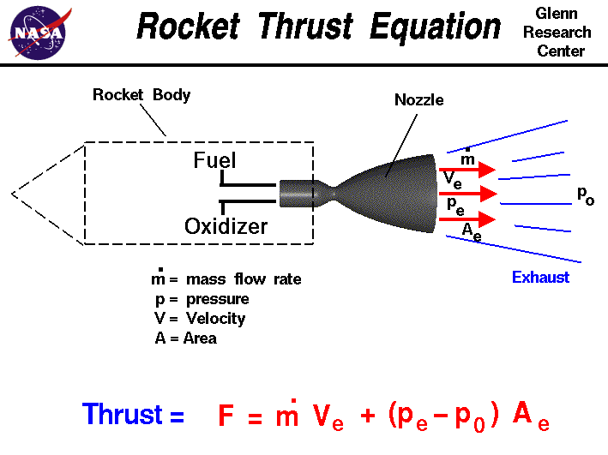
Important Laws and Equations.
Thrust Generated

Slide 11
Propellant
Rocket propellant is the reaction mass of a rocket. This reaction mass is ejected at the highest achievable velocity from a rocket engine to produce thrust.

Slide 12
Propellent and it’s type.
Solid Propellant
They consist of a casing, usually steel, filled with a mixture of solid compounds (fuel and oxidizer) that burn at a rapid rate, expelling hot gases from a nozzle to produce thrust
Liquid Propellants
The fuel and oxidizer are stored in separate tanks, and are fed through a system of pipes, valves, and turbopumps to a combustion chamber where they are combined and burned to produce thrust.

Slide 13
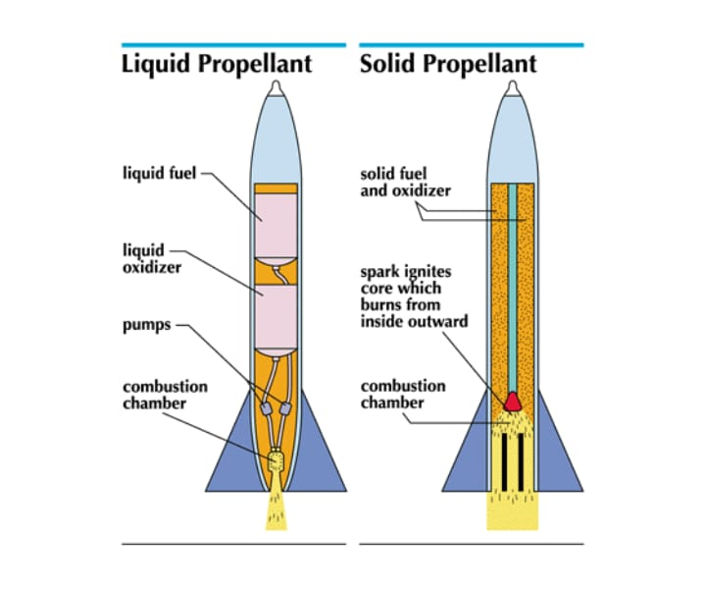
Propellent and it’s type.

Slide 14
Propellent and it’s type.
Hybrid Propellants
Hybrid propellant engines represent an intermediate group between solid and liquid propellant engines.
The liquid is injected into the solid, whose fuel reservoir also serves as the combustion chamber.

Slide 15
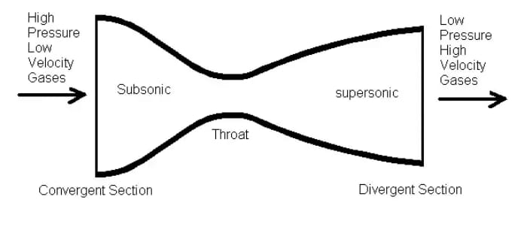
Nozzle and Combustion Process.
Nozzle
A nozzle is a relatively simple device, just a specially shaped tube through which hot gases flow. Rockets typically use a fixed convergent section followed by a fixed divergent section for the design of the nozzle.

Slide 16
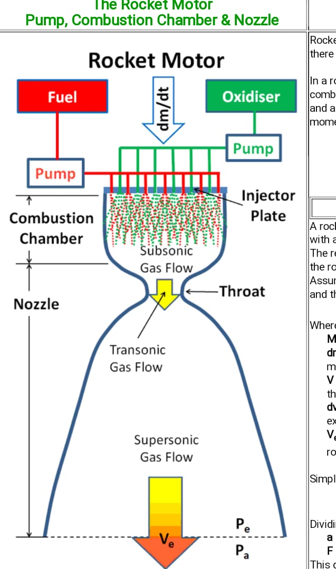
Nozzle and Combustion Process.
The function of the nozzle is to convert the chemical-thermal energy generated in the combustion chamber into kinetic energy.
Since thrust is the product of mass and velocity, a very high gas velocity is desirable.

Slide 17
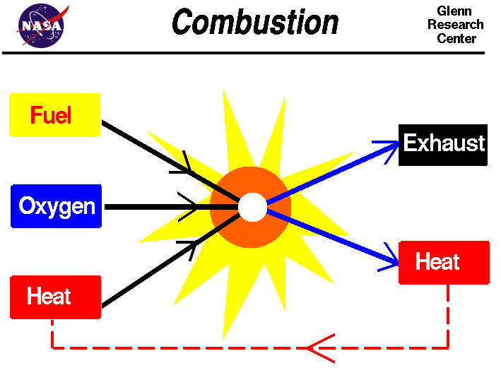
Nozzle and Combustion Process.
Combustion Process
In a rocket engine , fuel and a source of oxygen, called an oxidizer, are mixed and exploded in a combustion chamber.
For a rocket, the accelerated gas, or working fluid, is the hot exhaust produced during combustion.

Slide 18
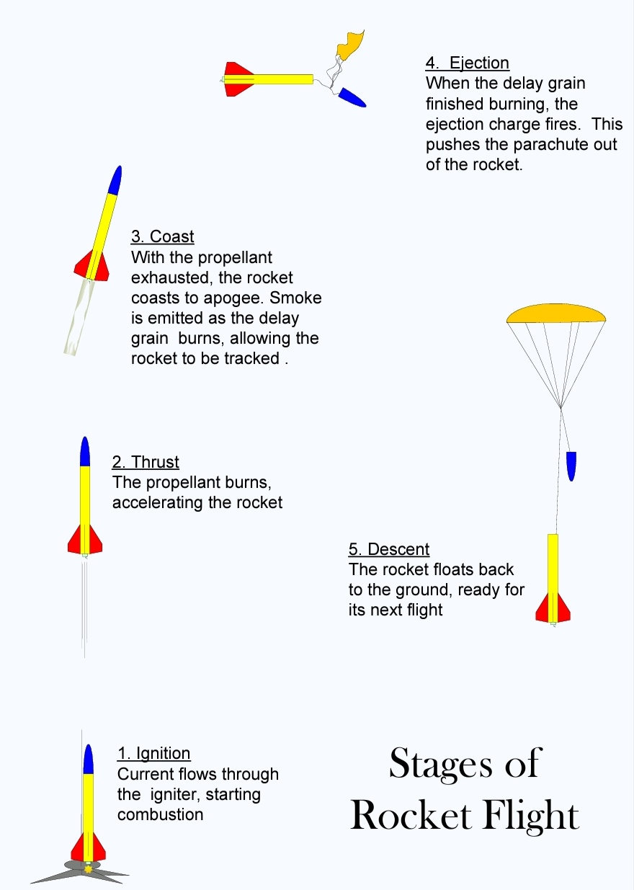
Model Rocket
6.1 Stages of a model rocket.

Slide 19
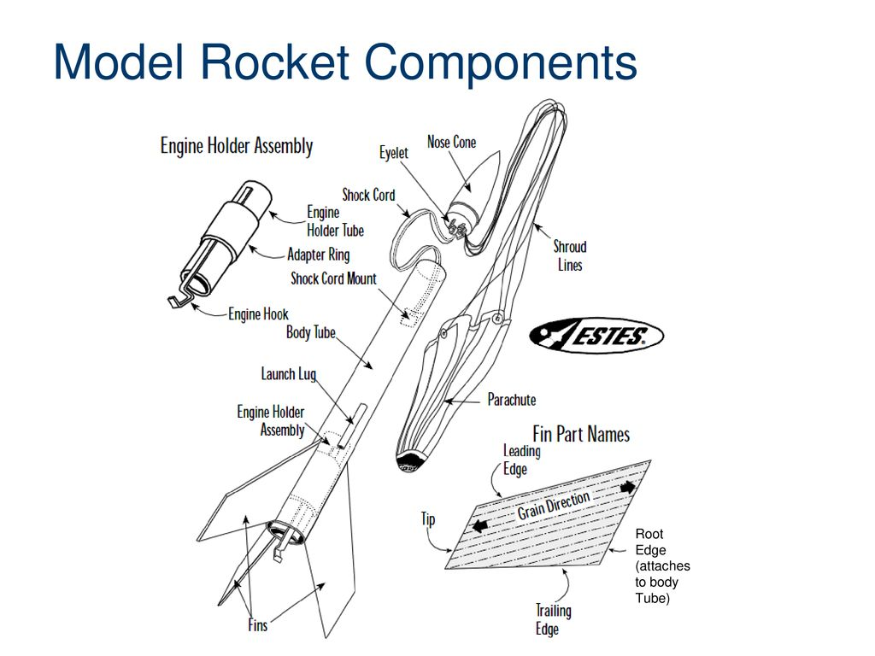
6.2 PARTS OF A MODEL ROCKET

Slide 20
6.2 PARTS:-
NOSECONE
The nosecone is aerodynamically shaped to minimize drag. It is loosely fitted into the body tube, and attached to the rocket body by the shock cord.
MOTOR ENGINES
Model rockets use small, pre-packaged, solid fuel engines The engine is used only once, and then is replaced with a new engine for the next flight.
RECOVERY WADDING
Recovery wadding is inserted between the engine mount and the recovery system to prevent the hot gas of the ejection charge from damaging the recovery system.
RECOVERY SYSTEM
This consists of a parachute (or a streamer) and some lines to connect the parachute to the nose cone. Parachutes and streamers are made of thin sheets of plastic.
SHOCK CORDS
An elastic shock cord is connected to both the body tube and the nose cone and is used to keep all the parts of the rocket together during recovery.
FINS
The fins can be made of either plastic or balsa wood and are used to provide stability during flight

Slide 21
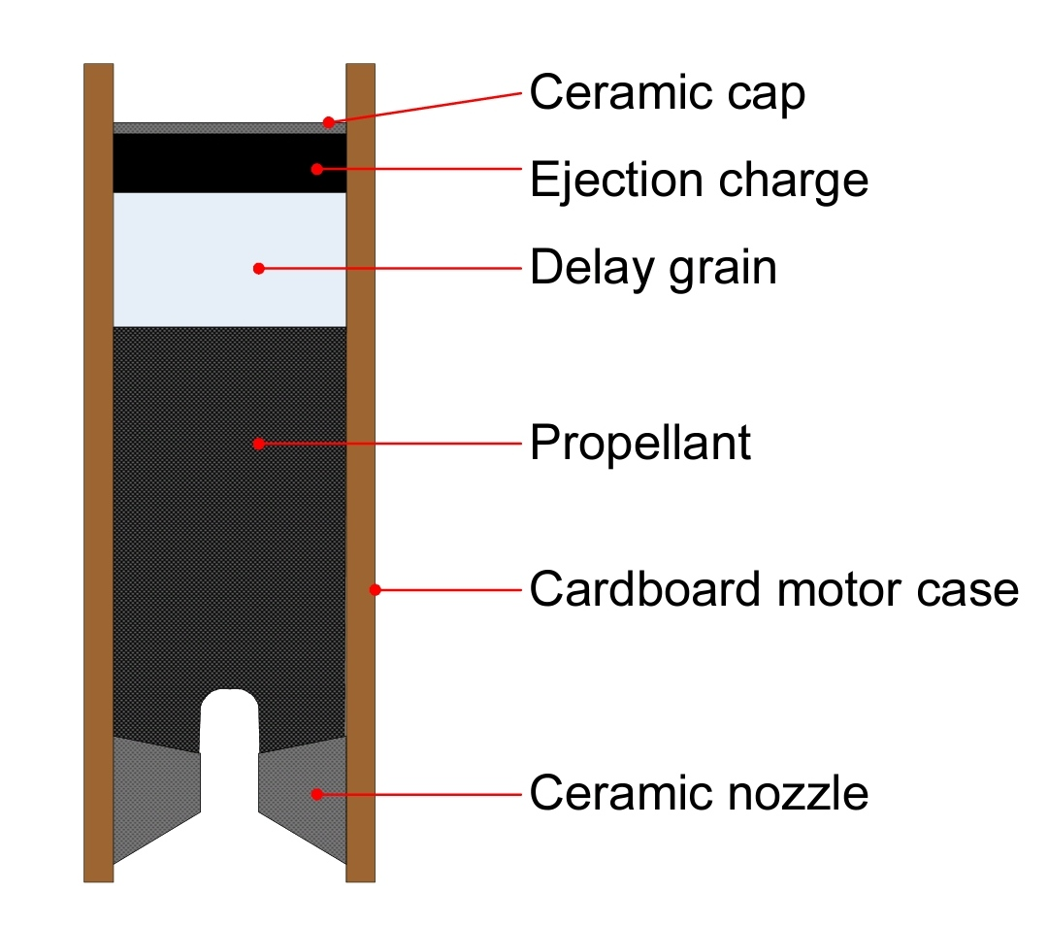
6.3 PARTS OF A MOTOR:-
The motor case is made of a thick and dense cardboard as it has to contain the pressure of combustion. The ceramic nozzle is molded into the motor. The propellant is black powder, sometimes called “BP”. The hot gas from the burning propellant is accelerated through the nozzle producing the motor’s thrust. When the propellant is all consumed it ignites the delay grain. This is a Sulphur rich powder which burns slowly, releasing smoke so that the rocket can be tracked while it coasts. When all the delay grain has been consumed it ignites the ejection charge. This small charge shatters the ceramic cap and pressurizes the rocket, forcing off the nosecone and deploying the parachute.

Slide 22
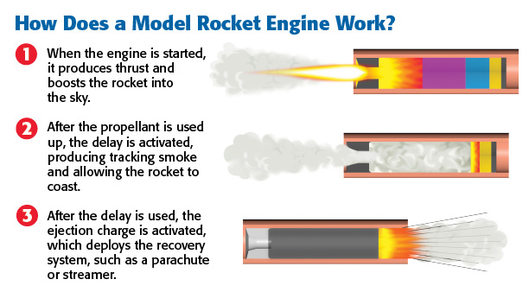
6.4 HOW A MOTOR WORKS:-

Slide 23
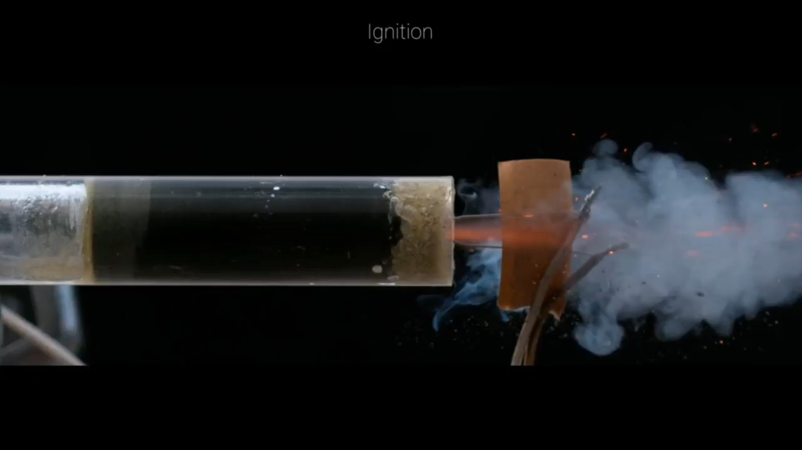
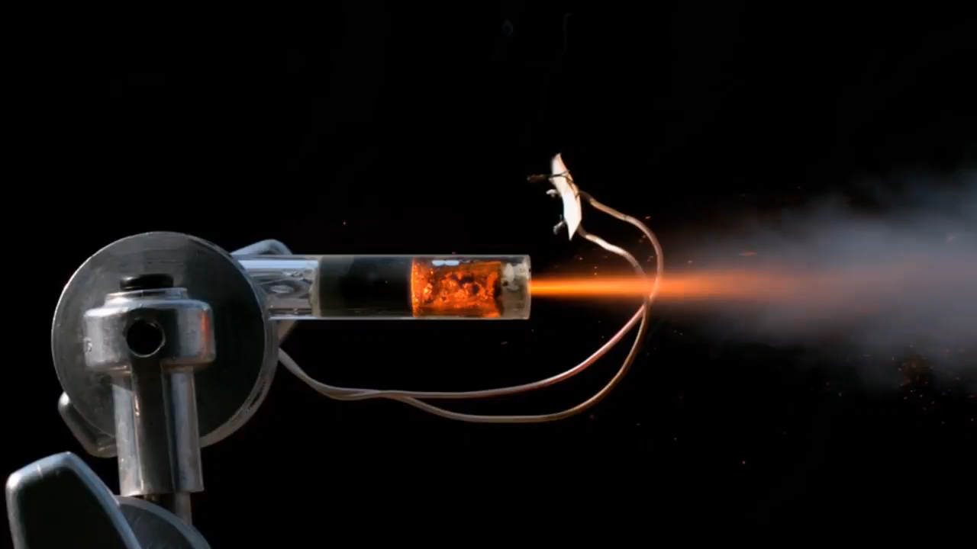

Slide 24
TYPES OF MOTORS:-
Black Powder Motors
Single-Use Composite Motors
Reloadable Composite Motors
Hybrid Motors

Slide 25
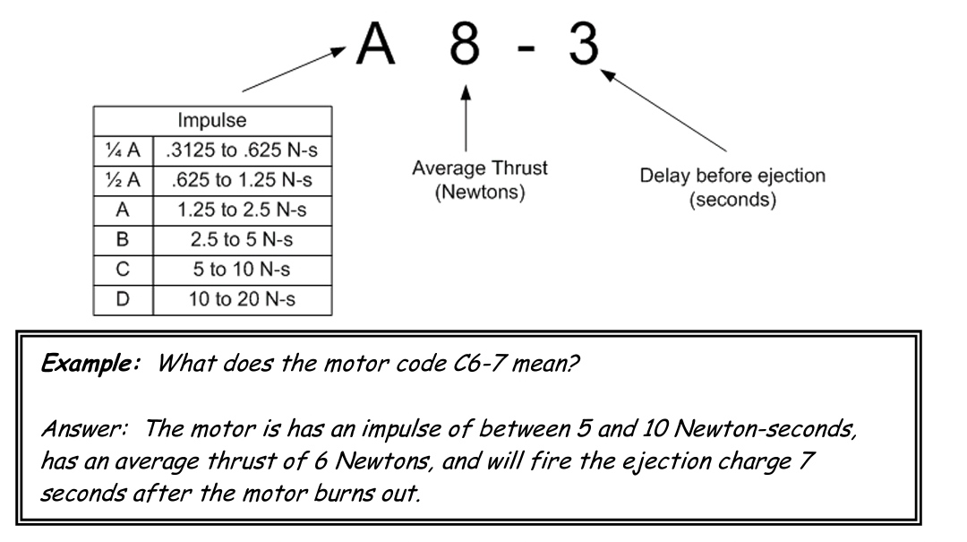
CODING OF A ROCKET MOTOR
We specify motors by three factors:
1.The average thrust which they produce
2.The time for which they produce that thrust
3.The delay before the ejection charge is fired. Clearly 1 and 2 are related. The same amount of propellant can be burned quickly to produce high thrust for a short time, or slowly to produce a small amount of thrust for along time. The combination of thrust and time is called the IMPULSE of the motor.
More scientifically :impulse = average thrust x burn duration. As thrust is measured in Newtons, and time is measured in seconds, then impulse is measured in Newton-seconds. The impulse is thus directly related to the amount of propellant. The more propellant, the greater the impulse of the motor.

Slide 26
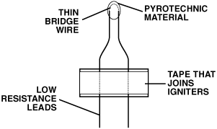
IGNITER AND LAUNCH CONTROL
An igniter is a device used to ignite a rocket engine. The igniter element is a strip of resistance wire with a coating of pyrotechnic material on it. The electric current from the launch controller flows through the igniter, the igniter begins to glow and give off heat. The pyrotechnic material, called the “pyrogen”, is ignited and is the last step in the ignition. Igniters must be installed so that the coating is touching the dark-coloured propellant grain. If the igniter is not touching the grain, this could cause a misfire

Slide 27
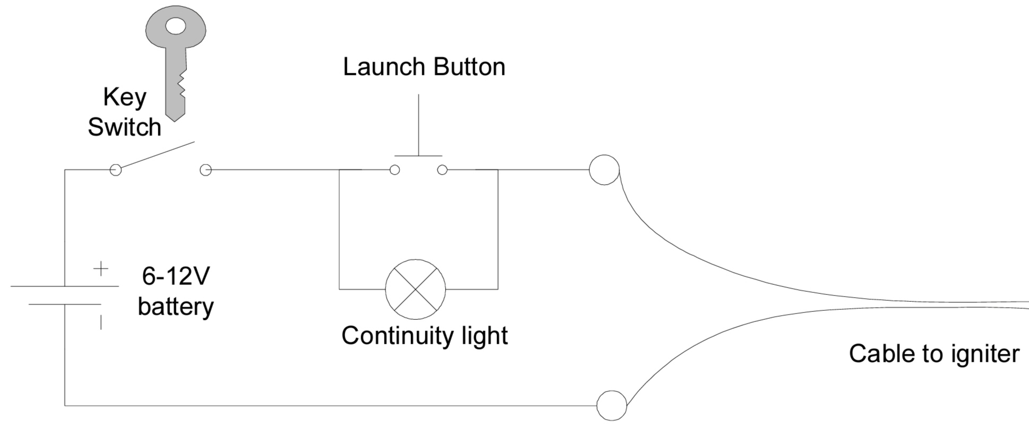
LAUNCH CONTROL :-
The launch controller provides the power to set off the igniter. It is essentially a battery and a switch; however it is designed with safety in mind. A key switch, or similar device, isolates the battery. Unless the key is inserted and turned there will be no power to set off the igniter. Controlling the safety key is a simple way of preventing accidents on the range. A diagram of a typical launch controller is shown below.

Slide 28
DELAY:-
Selecting a motor with the correct delay can make a big difference. If a rocket is expected to coast for 5 seconds then a motor with a delay of 5 seconds must be used. If the delay is too short the ejection charge will deploy the parachute while the rocket is still coasting. Similarly too long a delay will deploy the parachute while the rocket is descending. Deploying parachutes while the rocket is travelling at speed is a good way of damaging or destroying it.

Slide 29
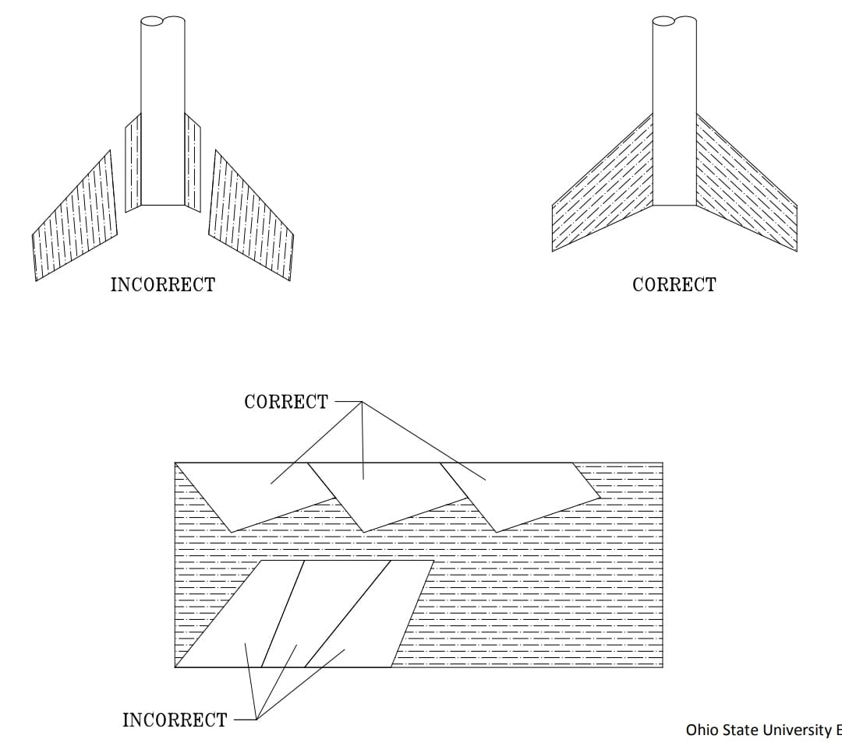
Stability
7.1 Importance of nosecone and fins.
Nose cone :The nose cone helps reduce air drag by streamlining the air as it flows past the surface of the rocket. Adding weight to the nose cone helps move the center of mass (CM) toward the nose of the rocket increasing the stability of the rocket.
Fins :Without fins, rocket will not fly straight. The larger the fins and the further back they are placed on the rocket, the further back the center of pressure (CP) will be thus increasing the stability of rocket flight. Balsa wood is used as the standard material for rocket fins as it is strong and light.

Slide 30
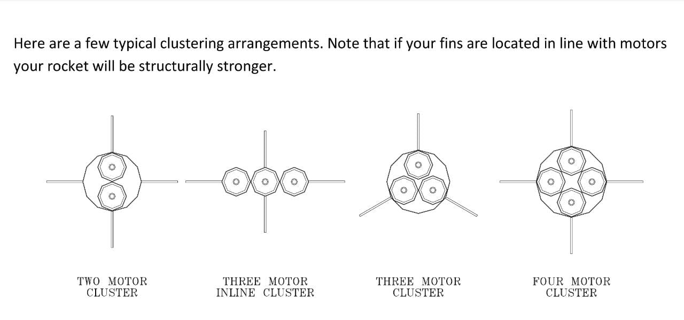
STAGING AND CLUSTERING
In order to lighten the weight of the vehicle to achieve orbital velocity, most launchers discard a portion of the vehicle in a process called staging. There are two types of rocket staging, serial and parallel.​In series staging Stages are attached, one on top of the other. In parallel staging one or multiple boosters attached to a central sustainer . At lunch all the engine ignites . When the propellant runs out all the strapped on boosters fall away.
Motor clustering is the use of more than one motor fired at the same time. Clustering adds together the thrust level, and thus the lifting or pushing power, of all the motors used. This makes it a good technique for lifting heavy payloads and large rockets.
Note that if your fins are located in line with motors your rocket will be structurally stronger

Slide 31
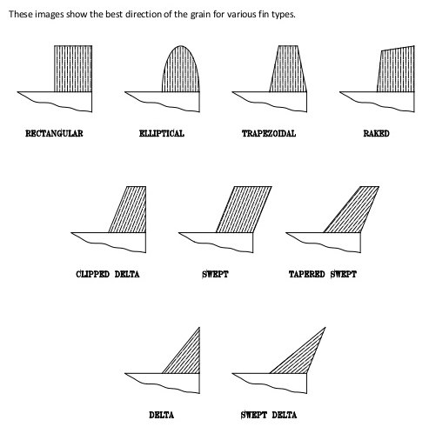
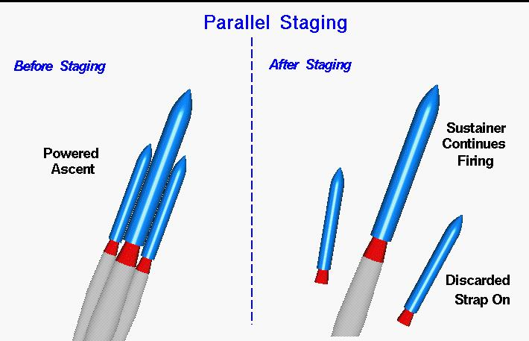
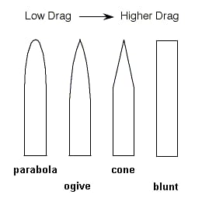
Staging and Clustering:-

Slide 32
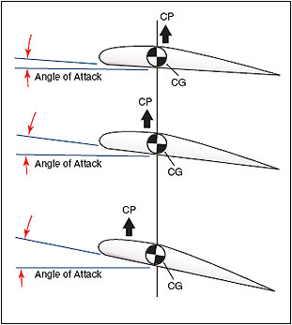
Center of gravity and center of pressure :
Center of mass is where rocket balances. Ie where the point where all mass of the rocket is concentrated. It's is necessary to determine CM because if the rocket is unstable it will tumble about this center.
​Center of pressure is the point where all the forces that are acting upon the rocket seems to be concentrated. IT should be located towards the tail because air imparts greater pressure at tail.

Slide 33
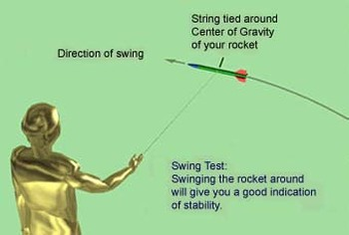
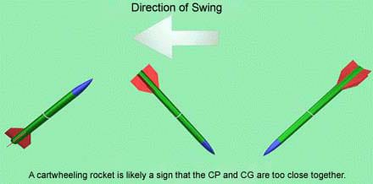
Swing Test:
The swing test is a basic test to give a rough idea how rocket will fly. If you swing your rocket and it points in the di-rection you swing it, it is a good indication that your rocket will be a stable flyer. If the rocket flies backwards. The motor is so heavy in comparison, then the Center of Gravity is very near the Center of the motor .Sometimes a rocket will just cartwheel by swinging it.
It is usually because of the CP and CG are too close together.

Slide 34
Parachute Deployment

Slide 35
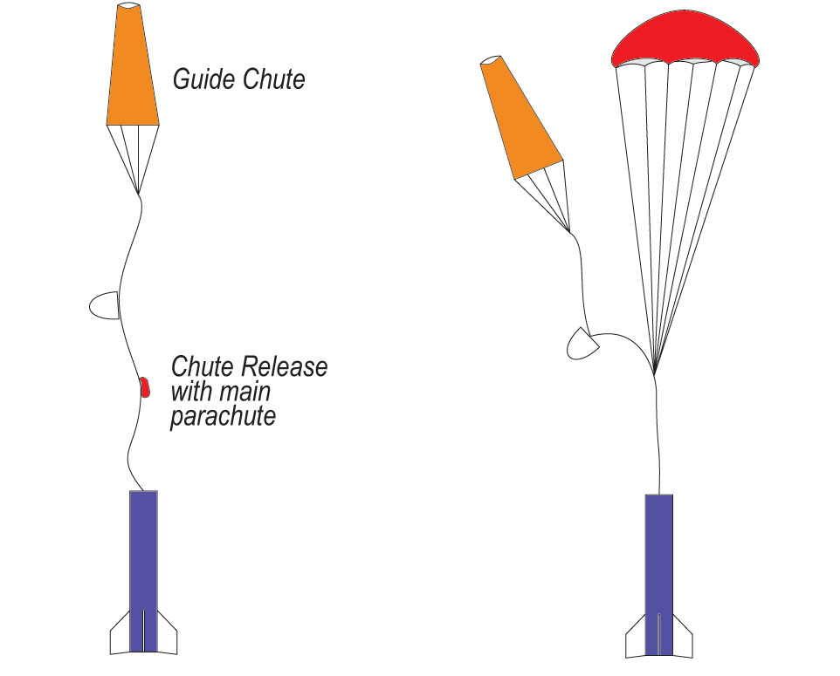
Parachute Deployment
Deployment of a parachute is defined as the process of extending the parachute canopy and suspension lines to a position at which satisfactory inflation can occur.

Slide 36
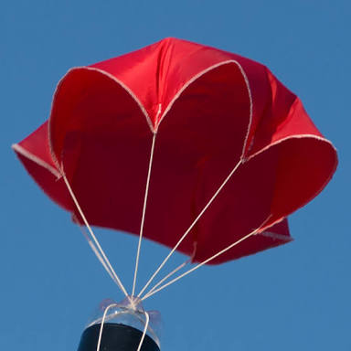
Parachute Deployment
The parachute is made out of two durable, lightweight fabrics: polyester and nylon.
The triple bridle is made out of Kevlar, the same material used in bullet-proof vests.
Before launch, a team must tightly fold together the 48 suspension lines, three bridle lines, and the parachute.

Slide 37
THANK YOU!
Group 0
Sidhant Kumar Raut
Subhankar Das
Jyostsana Kumari Gupta
Sudhanshu Panigrahi
Akankshya Pradhan
Subashree Dash
Aryan Patel

